Slide 1


Wanyue photoelectricity Technology(Zhuhai) Co.,Ltd

Slide 2
CONTENT
01
03
04
02
Group Introduction
Capability
Equipment Display
Product Introduction

Slide 3
01
Group Introduction

Slide 4
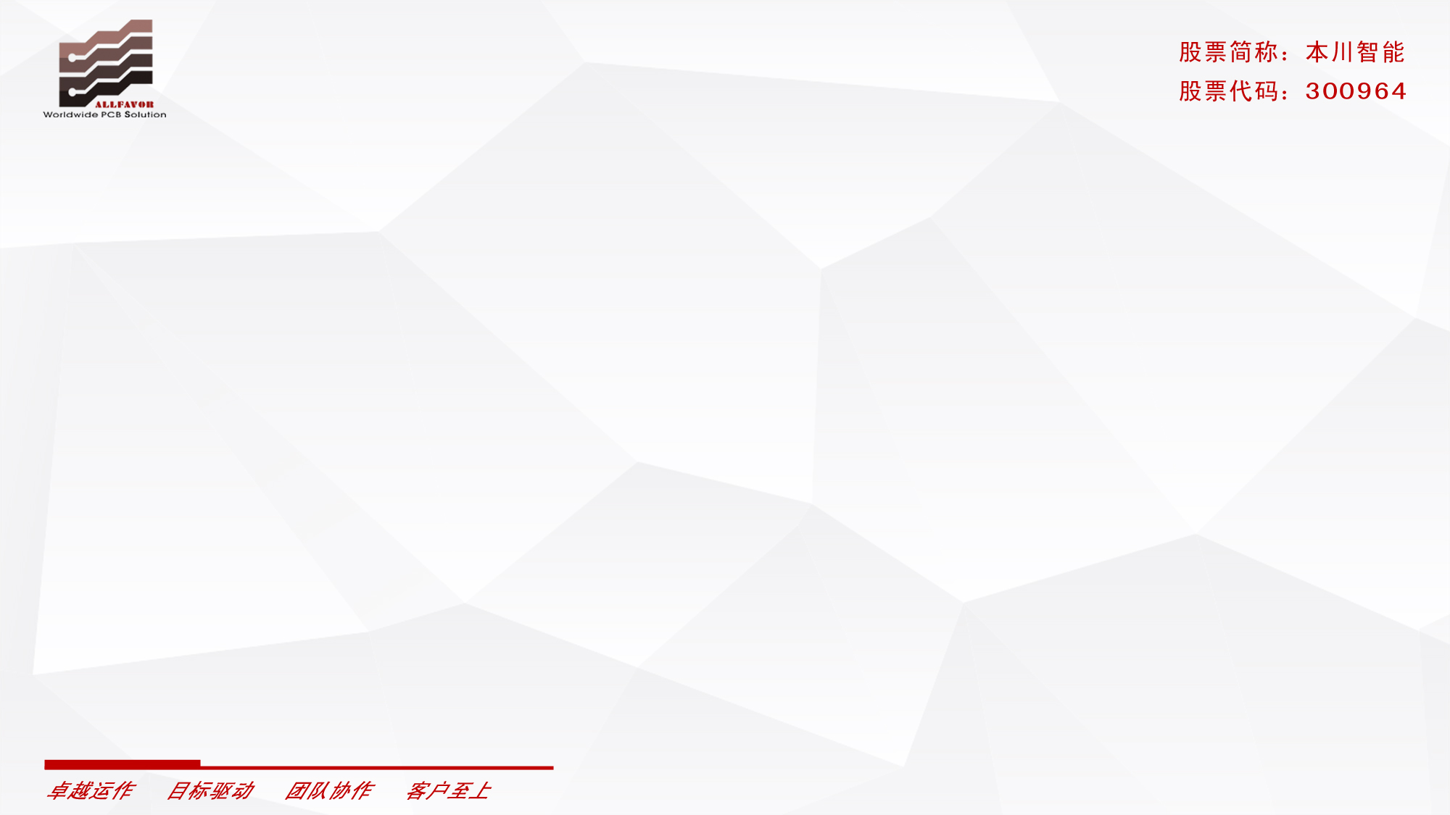
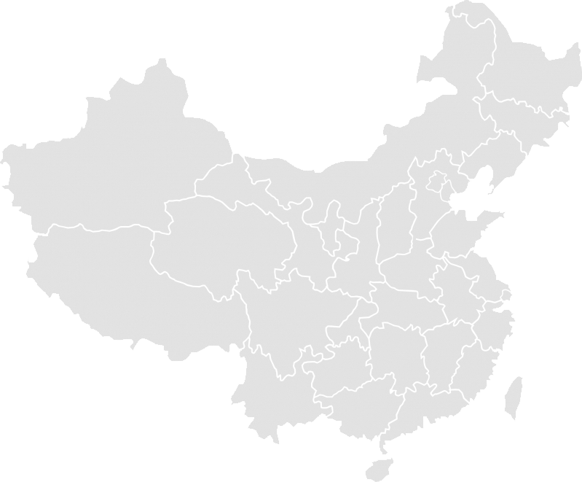
1. Chinese Factories
Rigid PC Board Manufacturer
Jiangsu · Nanjing
Jiangsu Allfavor Intelligent Circuits Technology Co., Ltd.
Focus on medium to high volume orders
Guangdong · Shenzhen
Allfavor Circuits (Shenzhen) Co., Ltd.
Allfavor Junling Circuits (Shenzhen) Co., Ltd.
Focus on high mix, low volume with a quick turn delivery
Guangdong · Zhuhai
Zhuhai Allfavor Shuohong Circuits Co., Ltd.
focus on high mix mid volume rigid PCBs
Flex and Metal PC Board Manufacturer
Zhuhai Allfavor Electronic Co., Ltd.
Focus on Flex and Flex-Rigid PCBs
Allfavor wanyue photoelectricity（zhuhai）LTD.
Focus on Metal base (Alu,Mirror Alu,Copper,
Ceramic base)
Shanghai
Guangdong · Zhuhai
Hongkong

Slide 5
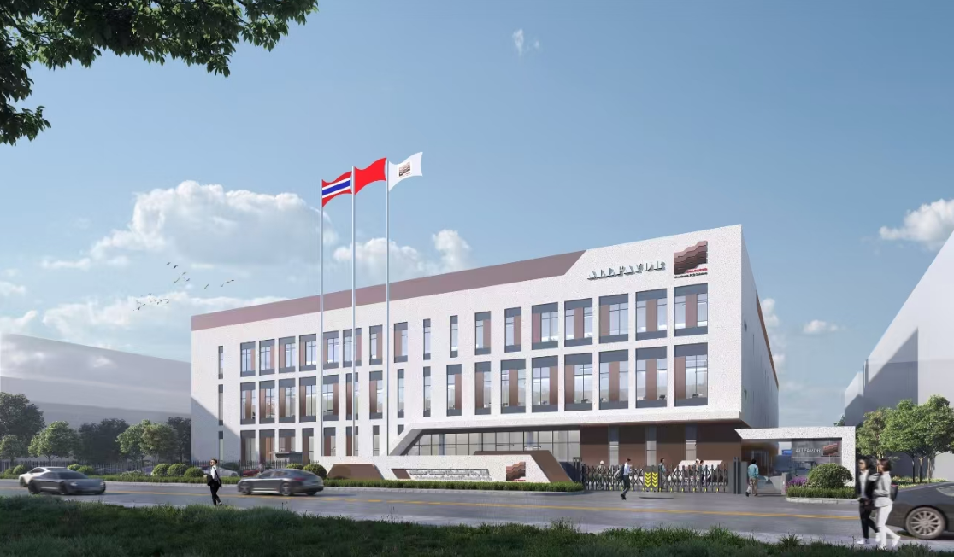
2. Thailand Factory
Company Name: ALLFAVOR CIRCUITS (THAILAND) CO., LTD.
Total Investment: 42M (USD)
Total Plant Area: 15000 squ meters
Plan Capacity: 40,000 sq.m. / Month
Staff（group): 300 employees
Location: Samut Prakan
Main Highlights:
Intelligent and Automation Factory;
IMS - Intelligent Manufacturing Systems;
MES (Manufacturing Execution System);
Lean Production Management;

Slide 6
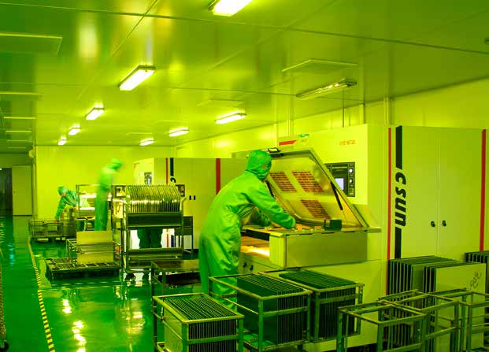
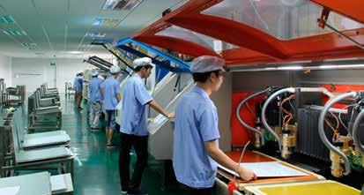
Wanyue photoelectricity Technology (Zhuhai) Co. Ltd,established in July 2018, the company covers an area of about 10000 square meters, with total investigation of 6M usd . It is a dedicated manufacturer with capacities of design, development and production of rigid PCBs which to various metal-based and ceramic-based circuit board.
Wanyue is committed to providing customers with the best service, and adheres to the basic principles of quality first, detail-oriented, on-time delivery, continuous improvement. we designs and produces different types of PCBs including single-sided, double-sided and multilayer board(Maximum 6 layers). The PCB thickness is from 0.1mm to 4.0mm and minimum track width is 3mil (0.075mm) etc.,

Slide 7
Guang Dong
Zhuhai
A2 Factory Building, 213 Anji Middle Road, Sanzao Town, Jinwan District, Zhuhai City, Guangdong Province

Slide 8
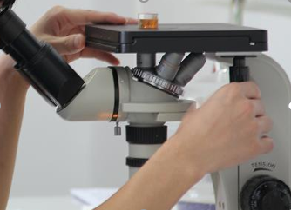

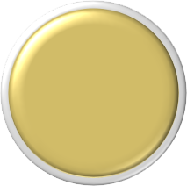

Production Capacity
Capacity
100000 ㎡/year
20000 ㎡/year
10000 ㎡/year
2023
2024
2025
The capacity of the new plant is 100,000 ㎡/ year, which is gradually increased by the upgrades of production and the market driven .

Slide 9
Quality System Certification
ISO9001
ISO14001
IATF16949
ISO13485
UL E301546
CQC
GJB 9001C
ISO9001
ISO14001
IATF16949
UL E301546
ISO9001
ISO14001
IATF16949
UL E473221
Nanjing
Shenzhen
Zhuhai

Slide 10
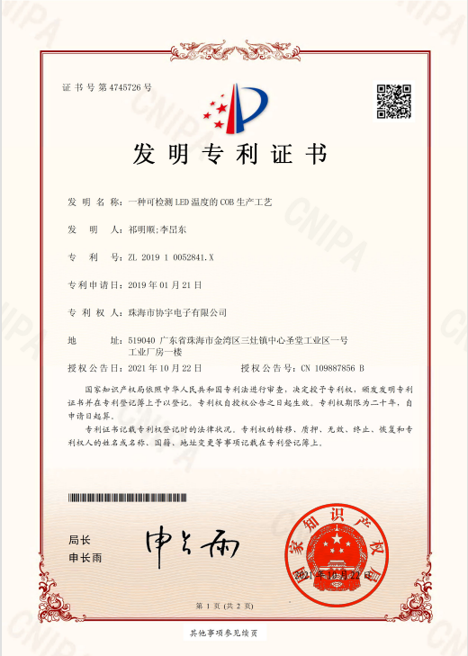
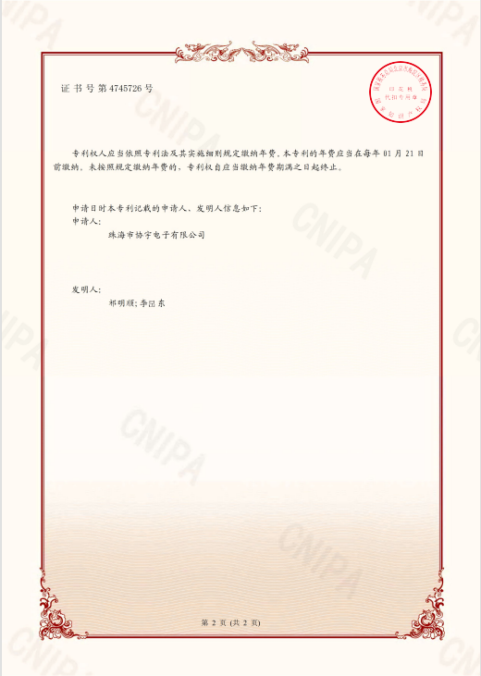
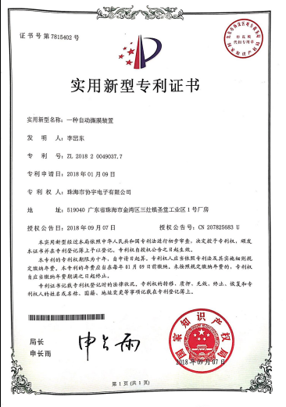
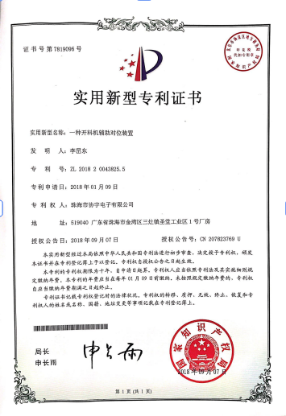
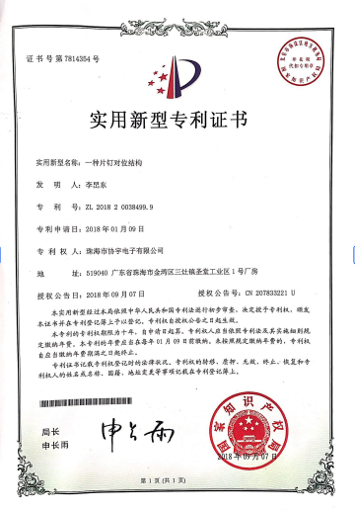
Invention Patent of Metal Clad PCB
2 Invention Patents
8+ Utility models
We are continuously applying for
more patents ...

Slide 11
02
Product Introduction

Slide 12
Main Application
Automotive electronics/LED automative lighting
LED headlight/taillight/interior lighting, vehicle motor control, electric power steering, vehicle power module, new energy vehicle battery management, charging pile, intelligent driving, IGBT
Industrial/Commercial equipment
Inspection equipment, industrial motors, tuners, power amplifiers
Security and protection
Smart surveillance, cameras
Application for MCPCB and ceramic-based circuit board
5G communication
Base Station, antenna
Medical industry
Medical equipment (ventilators, etc.)
LED lighting
Special lighting (e.g. stage lights, movie lights, surgical lights, etc.)
Industrial/commercial lighting (commercial lighting, street lamps, industrial and mining lamps, etc.)

Slide 13
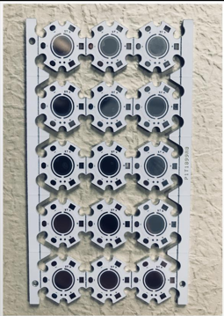
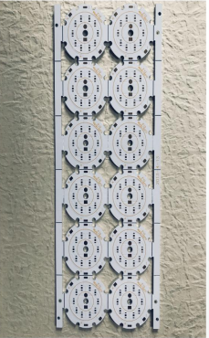
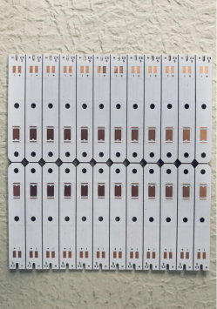
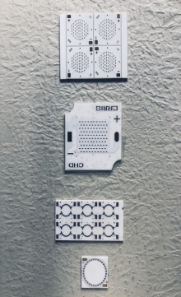
Main Products
Mirror Aluminum
Aluminum base
Copper base
Ceramic-base

Slide 14
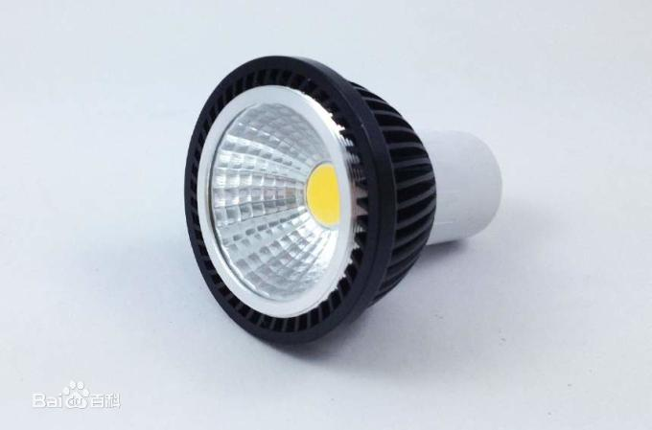

Product Features
Application
Features of Mirror Aluminum Substrate
1. It has high thermal conductivity, and the thermal conductivity can reach 220w by thermoelectric separation technology, which improves the heat dissipation of the chip and prolongs its life span. It is suitable for high-density packaging.
2. High light efficiency, full light reflection up to 98%。
3. We use ALANOD GmbH materials and pass SGS testing. It is safe, non-toxic and harmless.

Slide 15
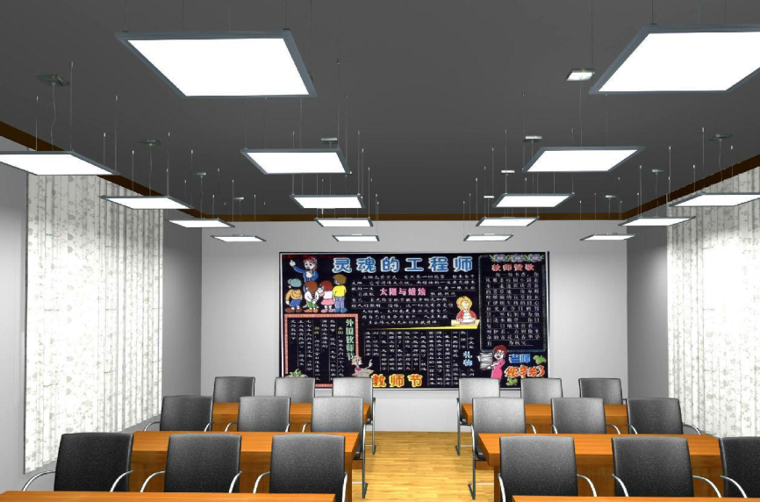
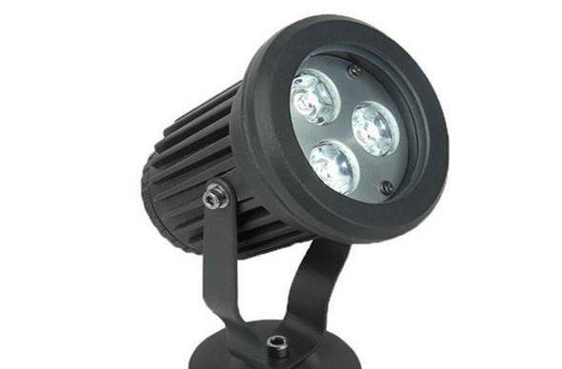
Product Features
Application
Features of Aluminum Substrate
1. The thermal conductivity currently used for aluminum substrates is 1-8w.
2. The size accuracy of the pad can reach ±0.05mm
3. Processing capacity
Minimum legend height :0.8mm
Minimum legend width :0.15mm
Minimum track width :0.075mm
Minimum track space :0.075mm

Slide 16
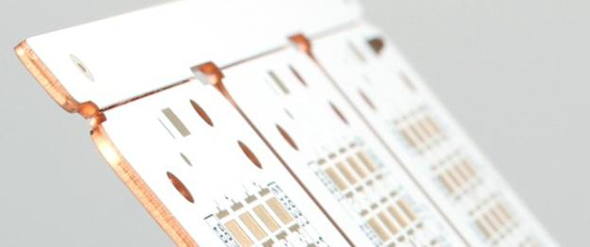
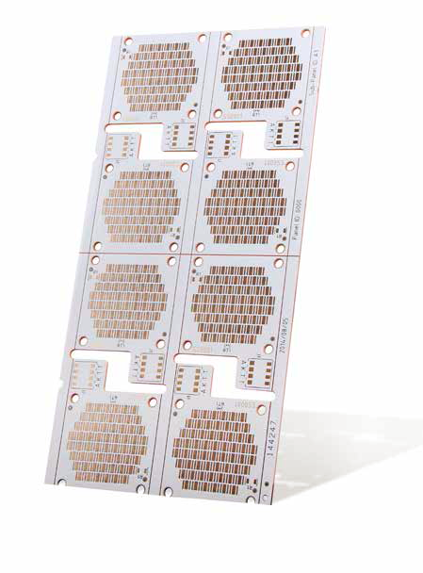
Product Features
Features of Thermoelectric Separation Copper base material
1. Convex, concave copper substrate technology can make the highest thermal conductivity of 398W/m.k. High heat transfer efficiency, fast heat dissipation.
2. The bow and twist of the copper base are smaller, and the overall performance is very stable.
3. The thermoelectric separation copper substrate has a good heat dissipation effect on the high-power LED module。
4. Under the same conditions, the temperature of the thermoelectric copper substrate is much lower than that of the ordinary copper substrate.

Slide 17
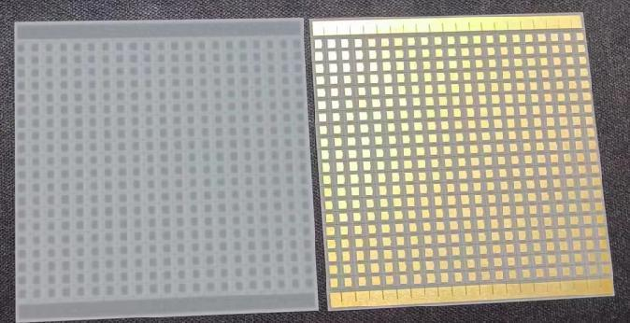
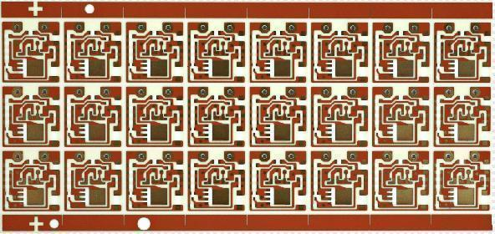
Product Features
Features of Ceramic-based Board
1. Stable performance under high temperature and high humidity.
2. High thermal conductivity and excellent heat resistance.
3. High insulation resistance, low dielectric constant and low dielectric loss.
4. The substance used is harmless and non-toxic, and the crystal structure does not change in the temperature range.
5. Ceramic-based Board has many characteristics, such as anti-impact, scratch-resistant, wearproof, easy to clean, moistureproof, UV-resistant, fireproof, anti-static and chemically resistant.

Slide 18
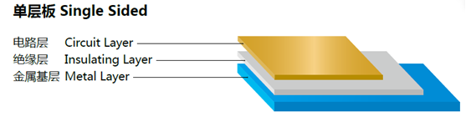
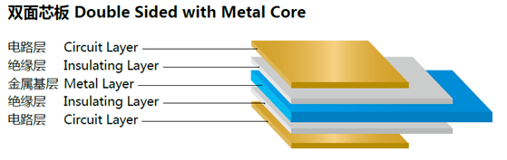
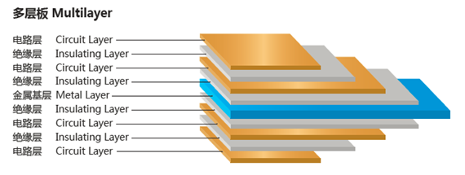
Product Structure

Slide 19









Partners

Slide 20
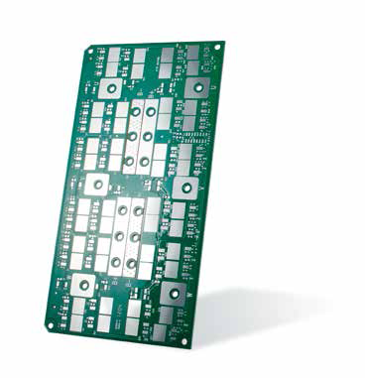
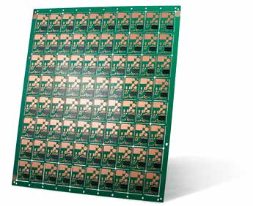
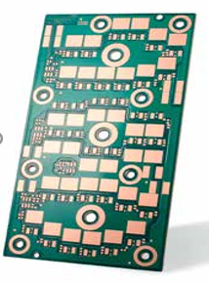
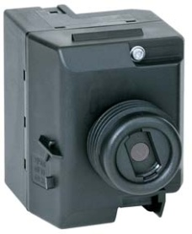
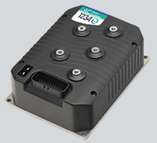
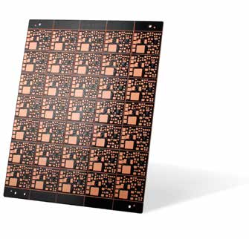
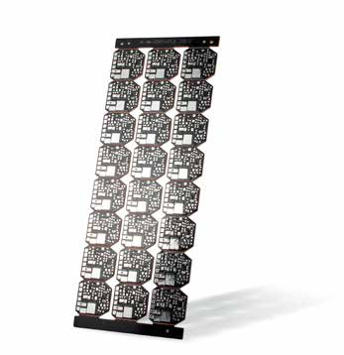
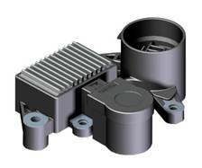
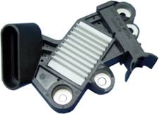

Product Display
High Resistance Carbon Bridge, Laser Thru Hole (PTH)
2 layers AL base board, 5/5oz copper, LF HASL
6oz Copper Foil
Blind Hole Connected Copper Base

Slide 21
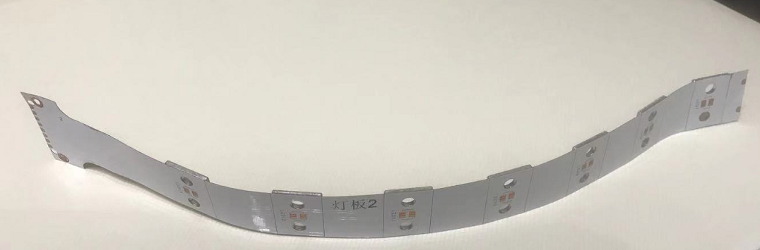
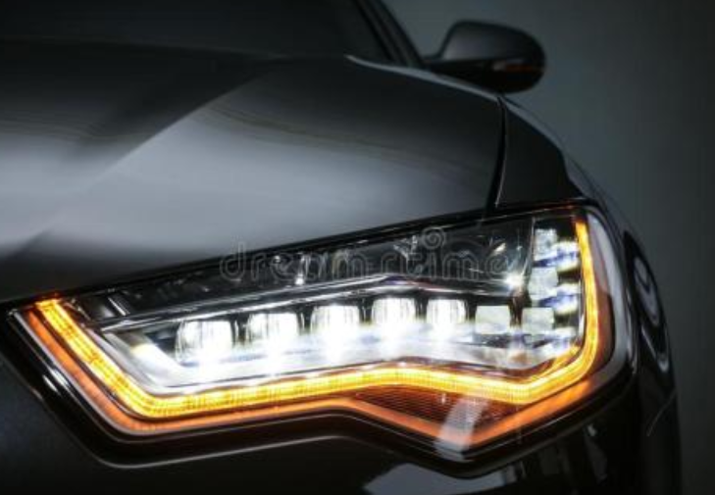
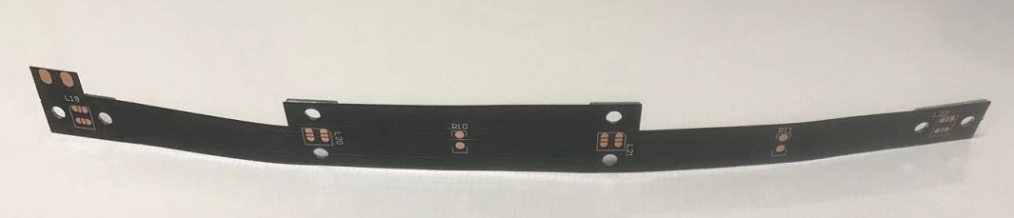
Product Display
automative lighting
Combination of hard and soft Metal Base

Slide 22
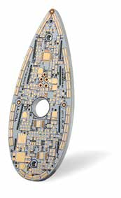
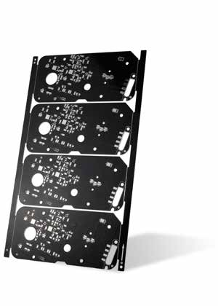
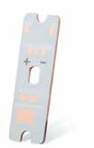
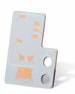
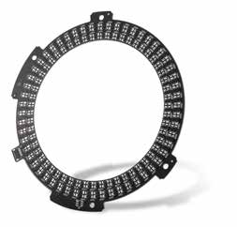
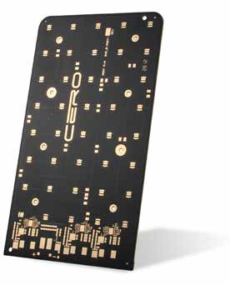
Product Display
silver filling the hole, circuit and copper base conducted
thermoelectric separation copper substrate
4-layer Al base board
single-sided double-layer
Al base
circuit and copper base conduc]ted
thermoelectric separation board

Slide 23
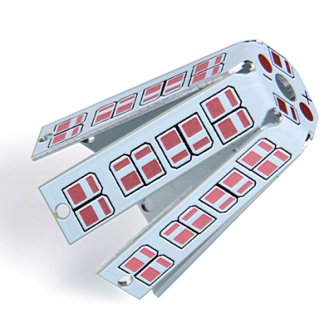
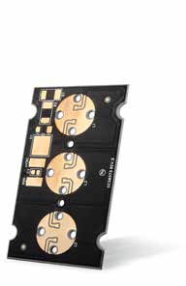
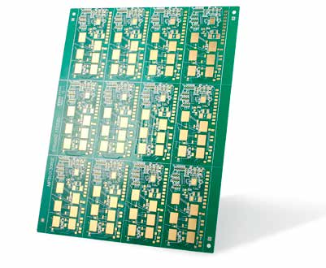
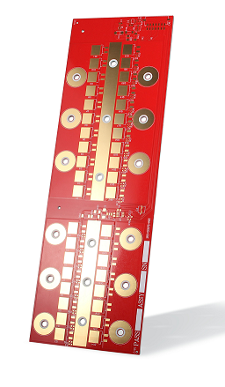
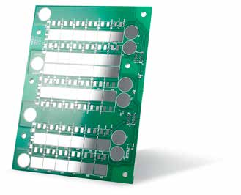
Product Display
Al base bent board
4oz copper Al base PCB
2oz copper, 0.1/0.1mm track width/ track space
4oz copper Al base board
4oz copper Al base board

Slide 24
03
Capability

Slide 25
Capability
Process and Technical parameter——
DPC copper-clad ceramic substrate
Technical parameter | Craft ability
Material | Alumina, aluminum nitride, silicon nitride, silicon carbide, ZTA toughening ceramics, etc
Board thickness(mm) | 0.127mm/0.15mm/0.20mm/0.25mm/0.38mm/0.5mm/0.635mm/ 0.76mm/0.89mm/1.0mm/2.0mm/3.0mm
Layer | Single side with single layer、double sides wih single layer
Copper thickness(um) | 3um-100um，100um-800um
Surface treatment | OSP、Immersion silver、ENIG、ENEPIG
Track width/ track space(mm) | Track width≥0.075mm/track space≥0.075mm
Minimum hole size(mm) | 0.06mm(Conductive hole)
Finished hole tolerance（mm） | NPTH±0.05mm PTH±0.076mm(Plug-in hole)
Dimension tolerance（mm） | ±0.05mm
Minimum distance from line to board edge(mm) | 0.1mm
Finished board thickness tolerance(mm) | Finished board thickness(0.127-0.25mm)tolerance±0.01mm Finished board thickness(0.25-0.38mm)tolerance±0.03mm Finished board thickness(0.38-0.635mm)tolerance±0.04mm Finished board thickness(0.76-2.00mm)tolerance±0.05mm

Slide 26

04
Equipment

Slide 27
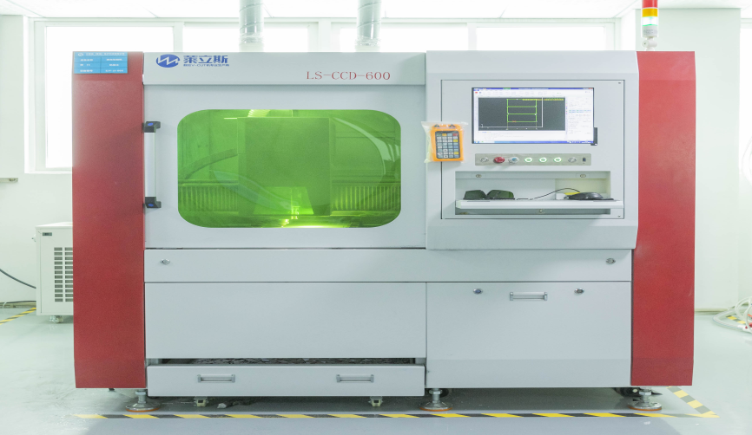





Manufacturing Equipment
Laser Cutting Machine
Auto V-cutting Machine
Exposure Machine
Silkscreen Printer
Routing Machine
Scrubbing Machine
27

Slide 28






Testing Equipment
On-line AOI
Peeling Strength Tester
Voltage Tester
Probe Flying Machine
CMI Tester
Metallographical Microscope
28

Slide 29






Testing Equipment
Chemistry laboratory
Coatings Analyzer
Hi-pot Tester
On-line AOI
2D measurement
V-CUT thickness tester
29

Slide 30
Thank you for watching
Service Beyond Expectation

